Slide 1
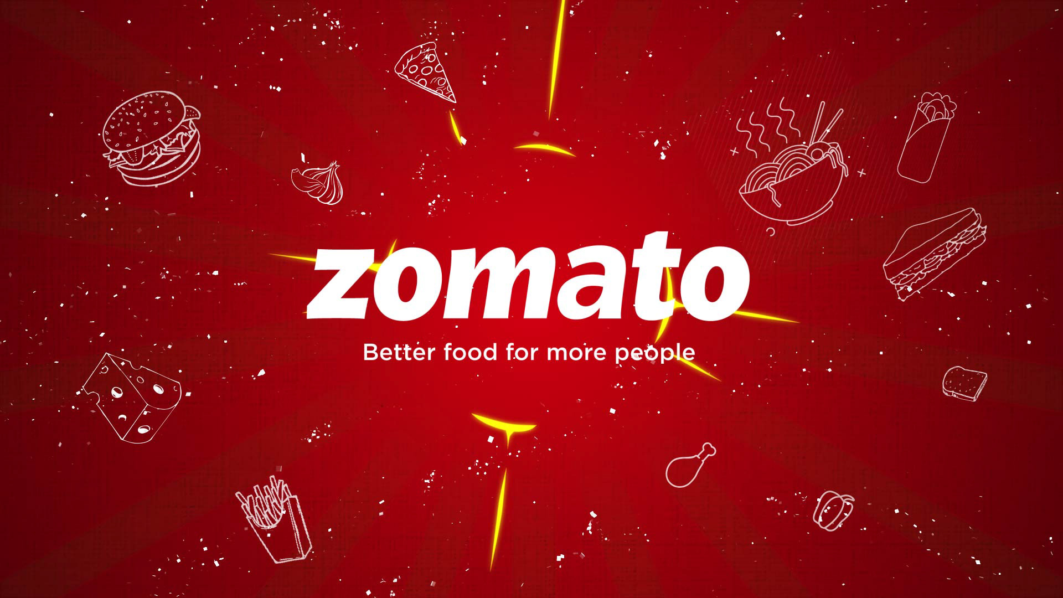
Bangalore Zomato Data
Ivy Excel Internship 2022
Zomato
Anshuman Chatterjee - 4535

Slide 2
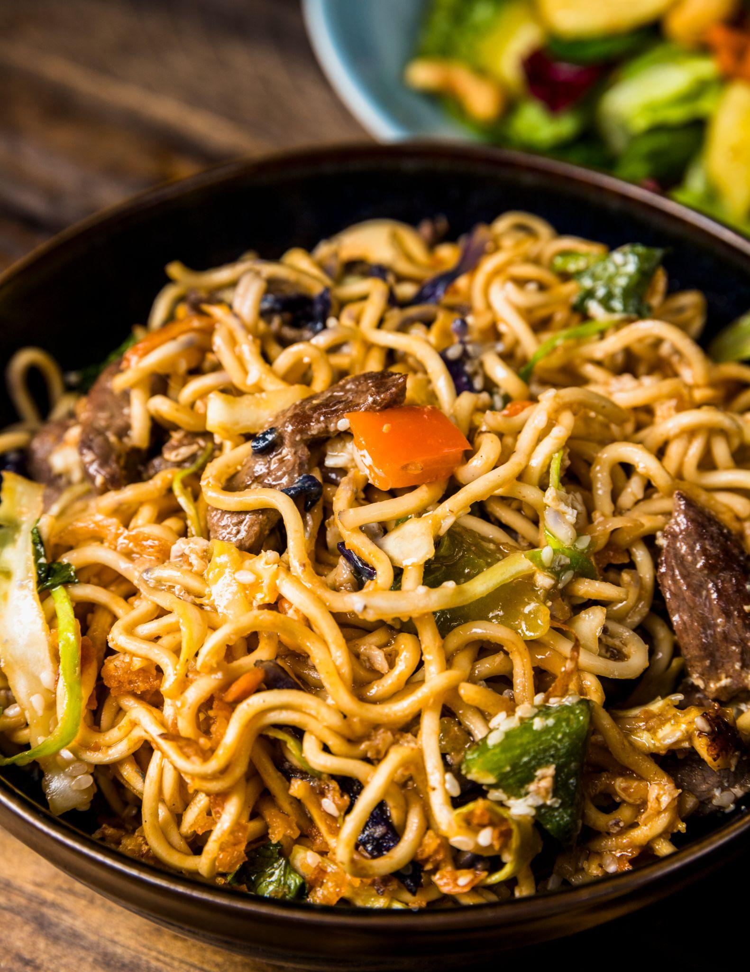
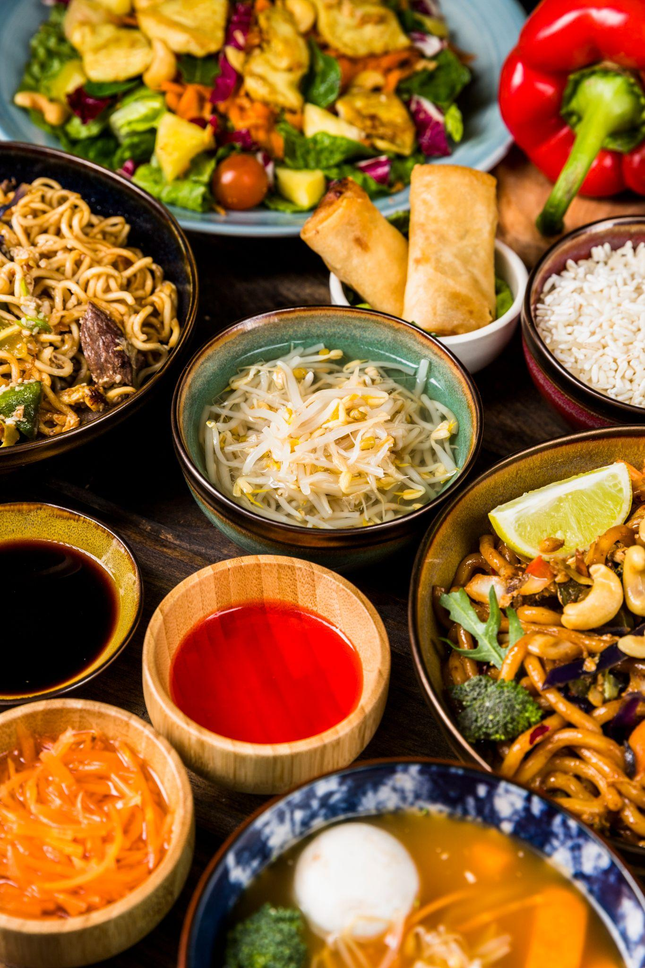
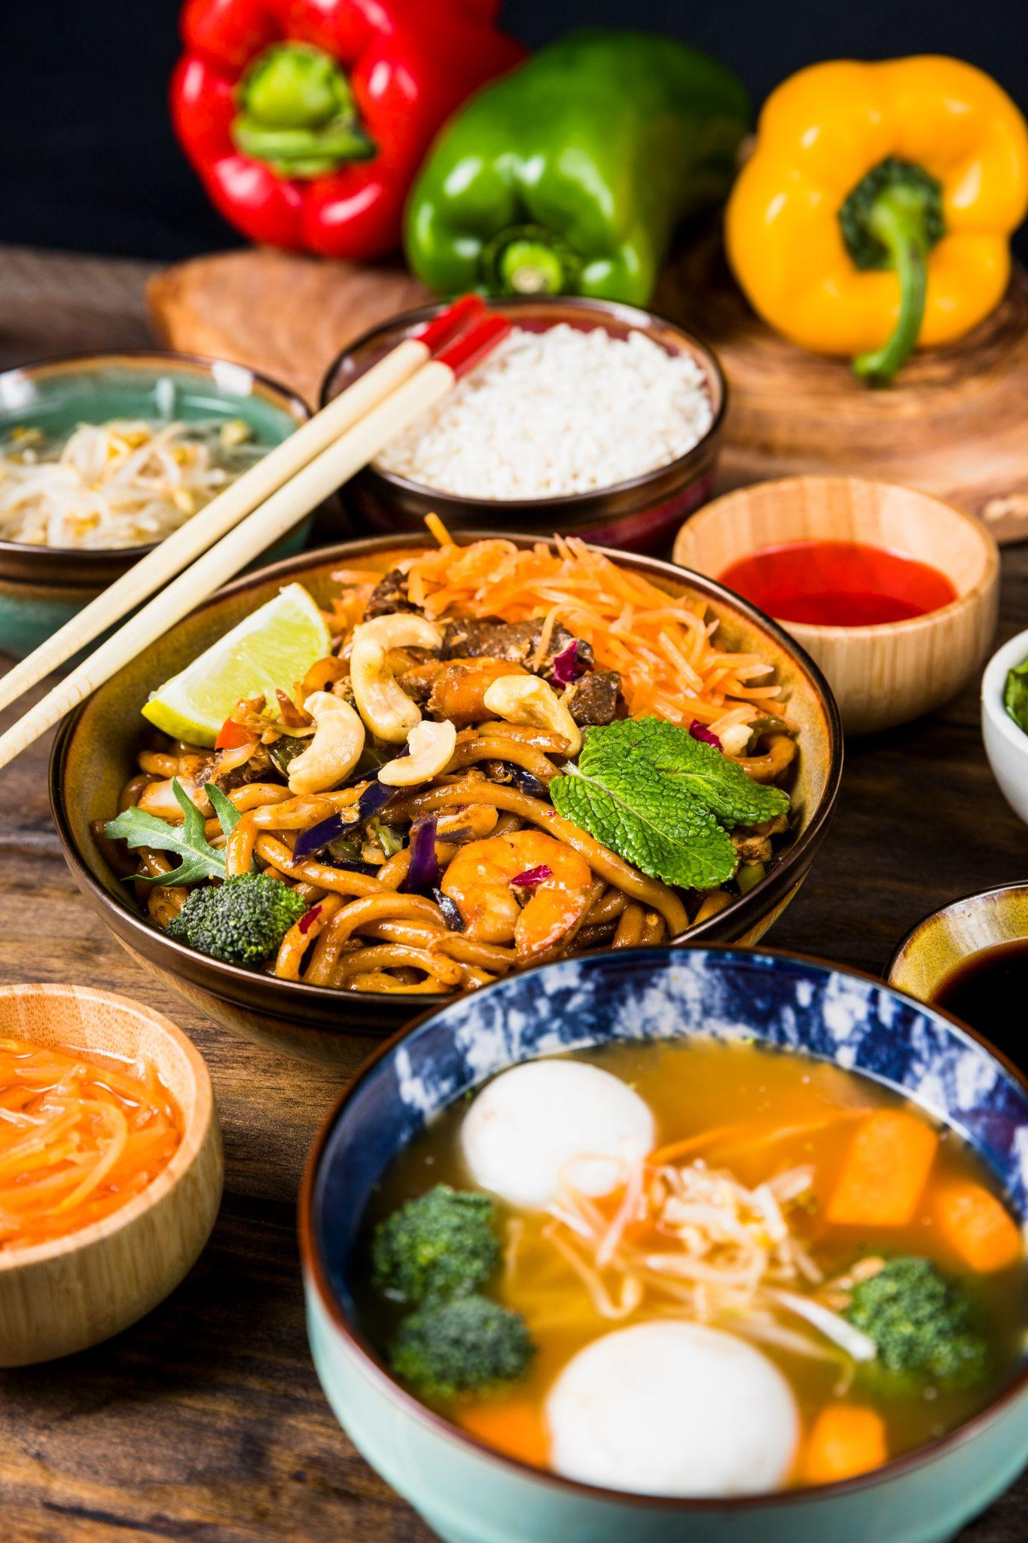
Bangalore Zomato Data
Contents
Case study
Objectives
Snapshot of data
Variables
Charts
Final Dashboard
Insights

Slide 3

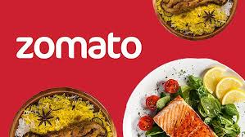
Case Study
This case study is all about the Bangalore Zomato data which I have analyzed using various factors like Name, Cuisines, Area, Indoor Seating, Dinner ratings, Delivery ratings, Average cost

Slide 4
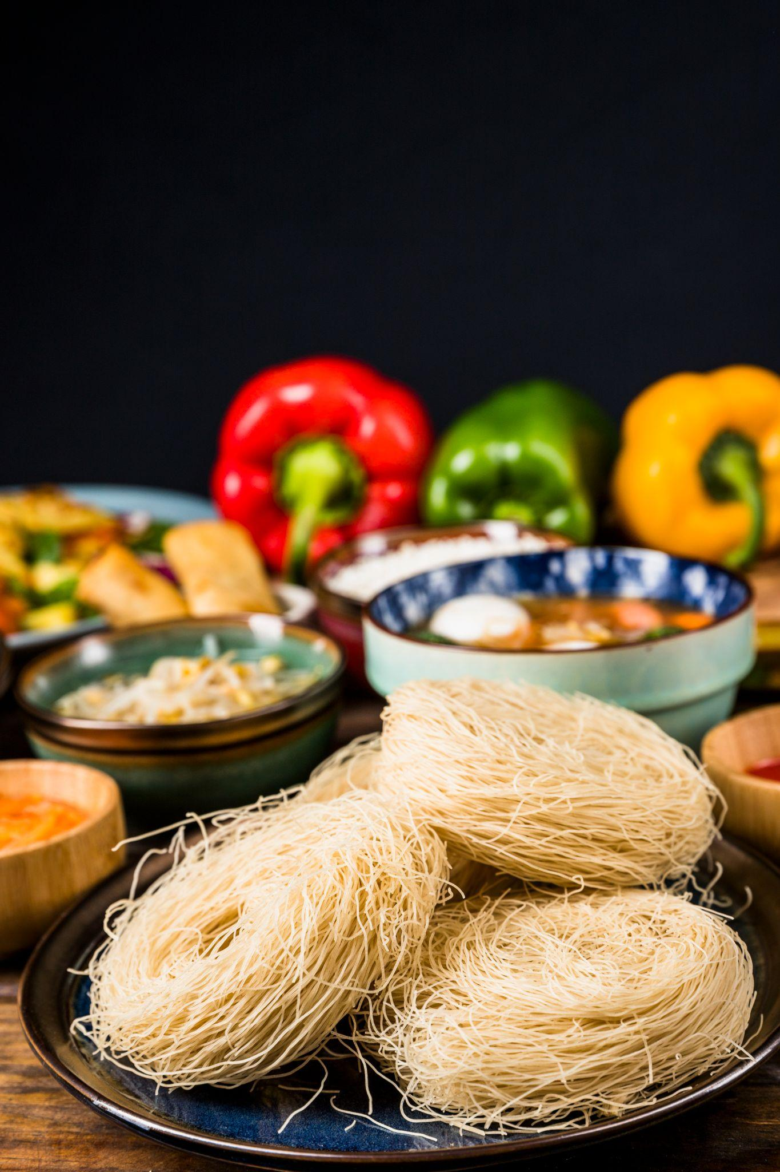
Objectives
Analyzing the Bangalore Zomato dataset using various excel tools and presenting it through PowerPoint
Solving real life business questions such as:
To find top 10 restaurant chains across Bangalore
Foodie areas in the city
Popular cuisines among restaurants
Seating Facilities
Rating By Average cost
Top restaurants by dinner & delivery ratings
Presenting the questions through various charts

Slide 5
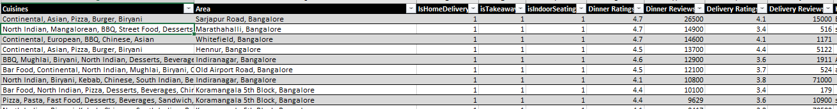
Snap shot of data

Slide 6
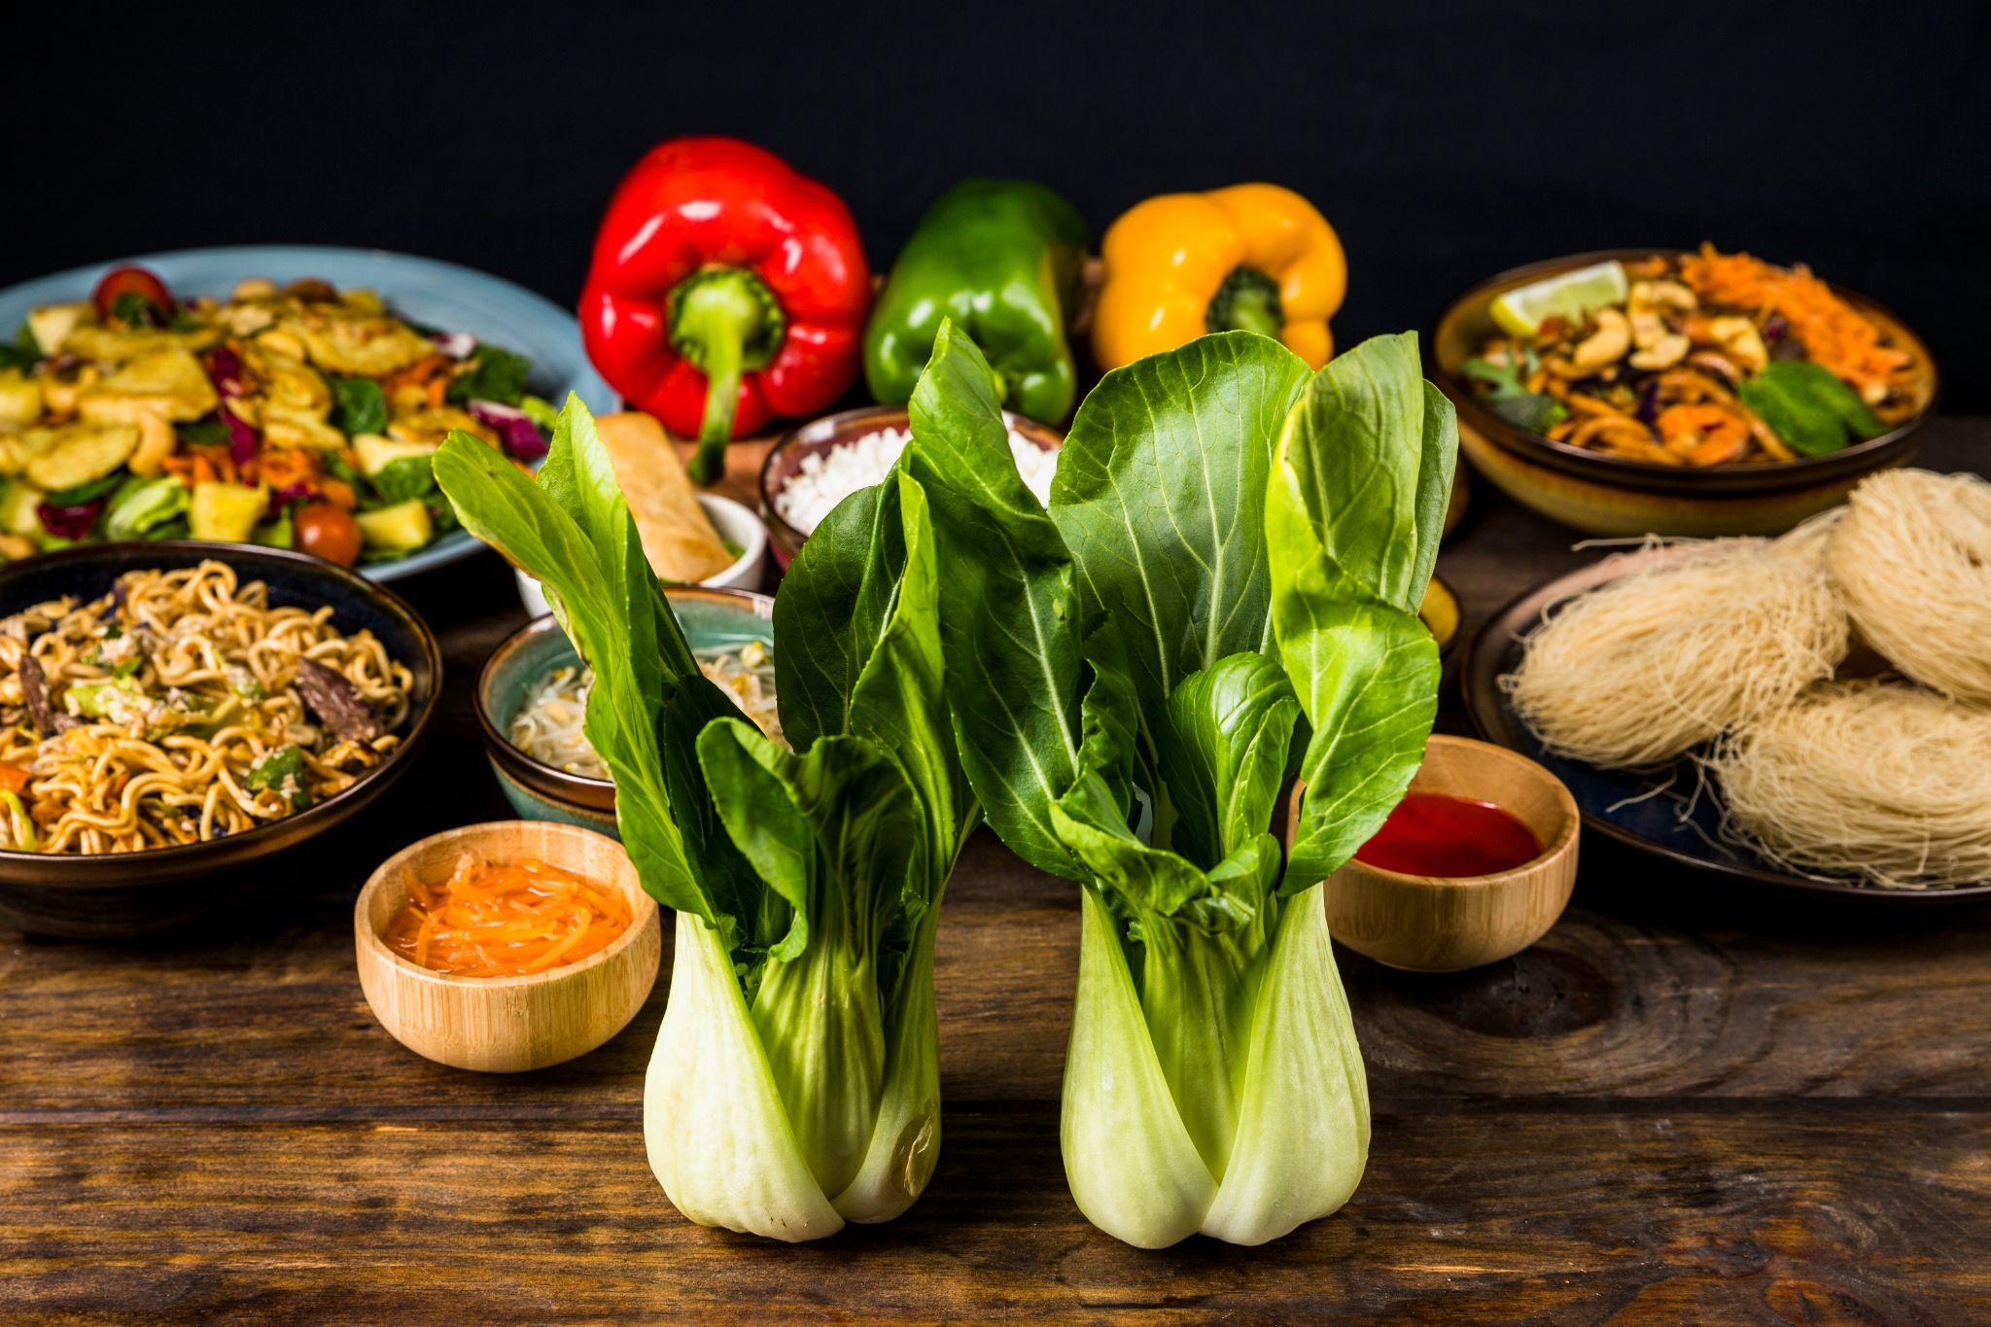
Variables
About the dataset
This dataset contains 18 fields and the important
fields with which i have worked are:
Name
Cuisines
Area
Indoor Seating
Dinner and Deliver Ratings
Average Cost
Zomato

Slide 7

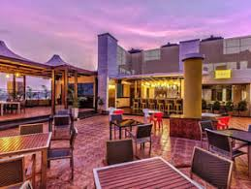
Top 10 Restaurant Chains across Bangalore
This graph shows that Five star chicken restaurant has got the highest number of chains across Bangalore followed by Kwality walls and Snack house

Slide 8

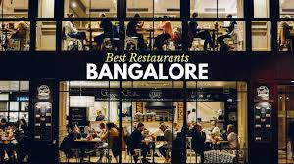
Foodie areas in the city
Through this chart Electronic city has got the highest number of restaurants followed by Marathahalli and HSR

Slide 9

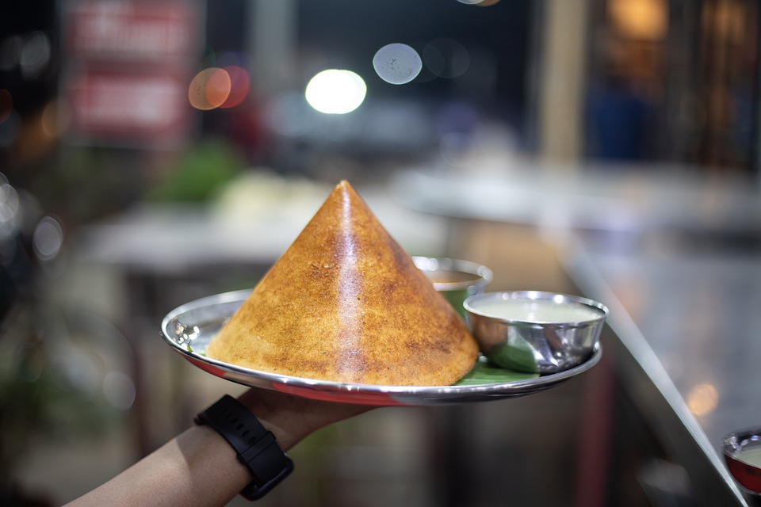
Popular Cuisines
Restaurants have various kind of cuisines but here south Indian cuisines are in demand among restaurants in Bangalore

Slide 10

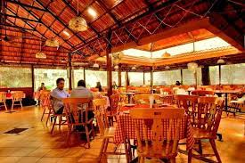
Seating Facilities
Through this chart i can see 44% of restaurants in
Bangalore have indoor seating facilities

Slide 11

Ratings by average cost
In this graph the number of ratings are gradually increasing with the decrease in average cost of each restaurant Hence i can analyze through this data that average cost ranging between 200 to 400 highly affects the orders placed in zomato.

Slide 12

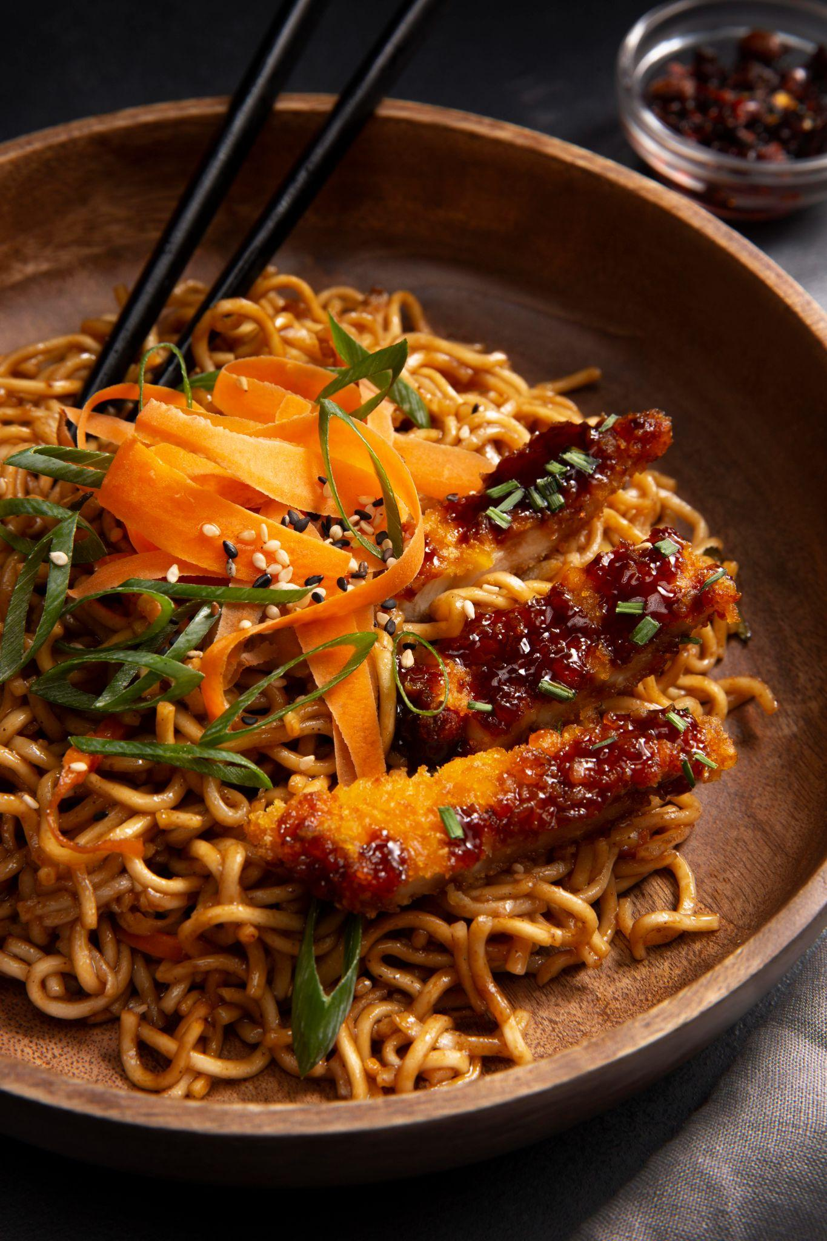
Dinner & Delivery Ratings
These are the top restaurants based on Dinner and Delivery ratings across Bangalore. From here it can be analyzed that all the restaurants range between 4 to 5 ratings.

Slide 13
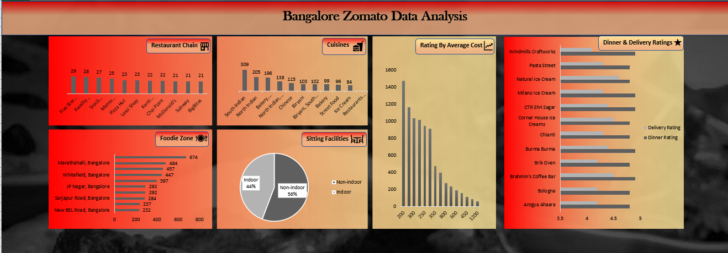
Final Dashboard

Slide 14
Insights
Here I have found out top 10 restaurant chains that can be displayed at the top of Zomato platform which will be beneficial for Zomato
According to foodie areas Zomato can increase the number of delivery person to fulfill more orders placed in Zomato
South Indian dishes should be introduced in all the restaurants, that will help increase the orders
As we can see 44% restaurants have indoor seating facilities so increase in seating facilities will attract more customers
As the average cost range is between 200 to 400 so every restaurants should try to cut down their average cost to make it pocket friendly to increase the number of customers
The graph helps analyze the ratings and also understand the type of services that customers are expecting out of them

Slide 15
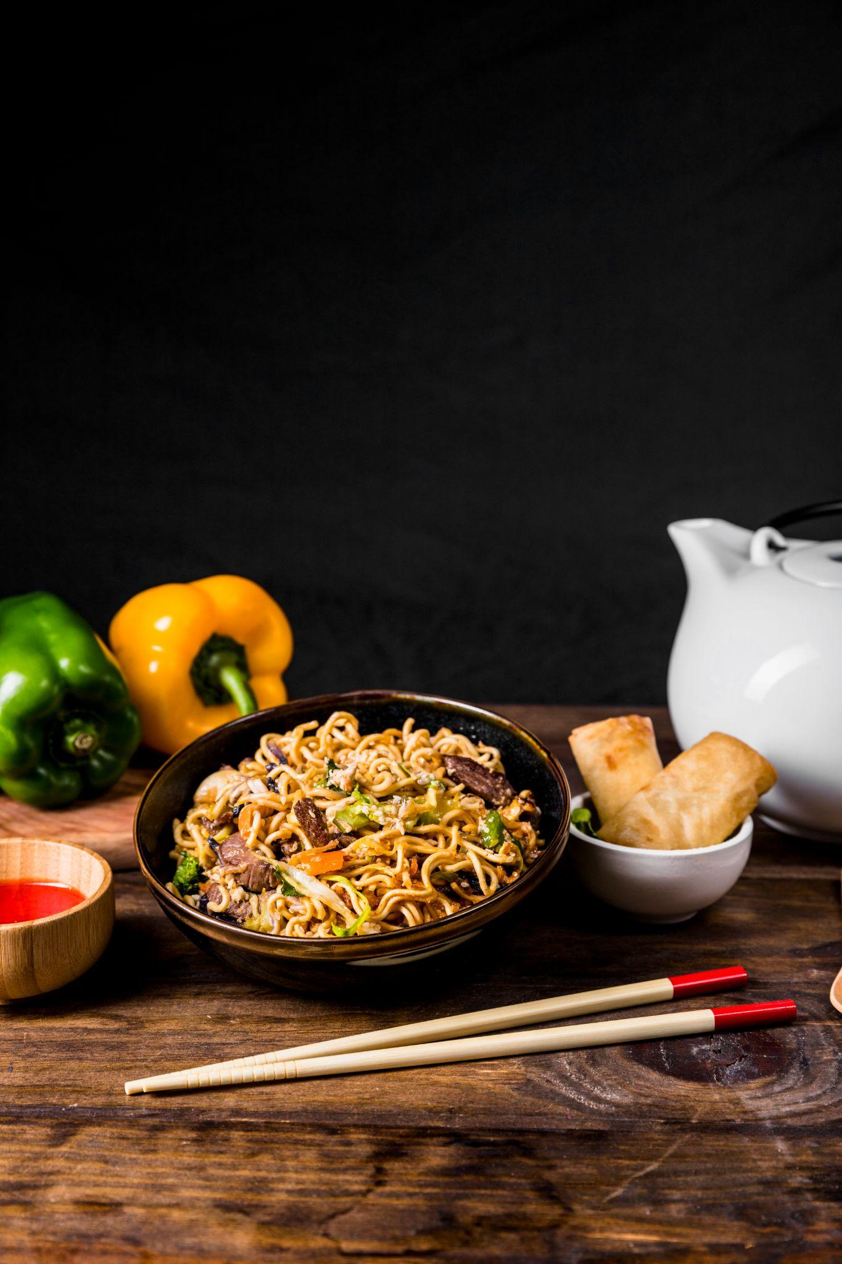
Thank You!

